Slide 1
Introduction to C++
Prateek Pudasainee

Slide 2
Recap
Limitations of structural programming. (C programming)
OOP(Object Oriented Programming).
C++, its history and its applications.
Characteristics of C++.
Difference between C and C++.

Slide 3
Contents
Basic structure of a C++ program.
Data Types and Modifiers.
Operators.
Conditional Operators.
Code demo.
Github and env setup.
Assignments

Slide 4
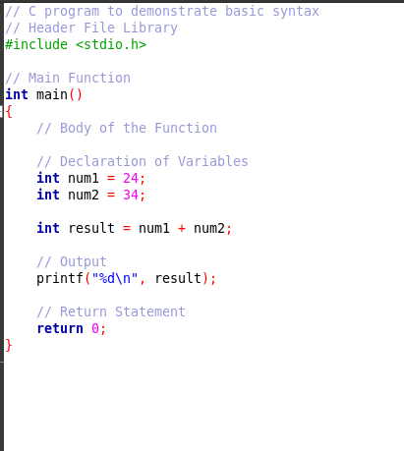
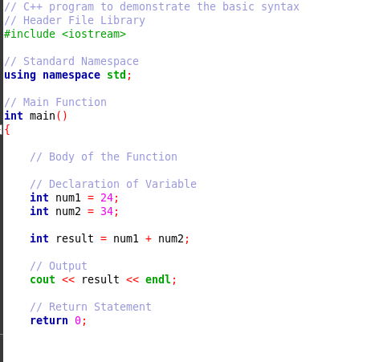
Basic Structure of a C++ program

Slide 5
Header File: Header files contain function and macro definitions. The #include <iostream> directive imports the iostream library, which provides cin and cout for input and output operations.
Namespace: A namespace defines a scope for identifiers to avoid naming conflicts. using namespace std; allows direct access to standard C++ functions without needing the std:: prefix.
Main Function: Every C++ program must have a main() function, as execution starts from it. It is defined as int main() and must return a value indicating the program's execution status.
Blocks: Blocks group multiple statements together, enclosed within {} braces. The body of the main() function is a block that contains the program's logic.
Identifiers: Identifiers are the names given to variables, functions, and user-defined data types. They can include letters, digits, and underscores but must start with a letter or underscore.
Keywords: Keywords are reserved words in C++ that have special meanings, such as int, return, and using. They cannot be used as identifiers for variables or functions.

Slide 6
Data Types
Most of the data types in C and C++ are same.
However , there are few data types that are different in C++.

Slide 7
Data Types (Basic)
Data type | Description | Example
int | Integer (whole numbers) | int x = 10;
char | Character (single letter) | char ch = 'A';
float | Floating-point number (decimal values) | float pi = 3.14;
double | Double-precision floating-point number | double e = 2.71828;
void | Represents "no type" (used for functions) | void function();

Slide 8
User Defined Data Types
Data type | Description | Example
struct | Group of different variables | struct Person { int age; char name[20]; };
union | Memory-efficient variant of struct | union Data { int i; float f; };
enum | Defines named integer constants | enum Color { RED, GREEN, BLUE };

Slide 9
C++ Specific Data Types
Data type | Description | Example
bool | Boolean (true/false) | bool a = true;
string | Represents text (from <string> library) | std::string name = "John";
wchar_t | Wide character type for Unicode | wchar_t wch = L'A';
auto | Automatically deduces type | auto num = 42;

Slide 10
Modifiers
Modifier | Usage Example | Description
short | short int x; | Uses less memory than int
long | long int y; | Uses more memory than int
signed | signed int z; | Allows positive & negative values
unsigned | unsigned int a; | Allows only positive values

Slide 11
Operators
Arithmetic Operators.
Relational Operators.
Logical Operators.
Bitwise Operators.
Assignment Operators.
Ternary or Conditional Operators.
Miscellaneous Operators.

Slide 12
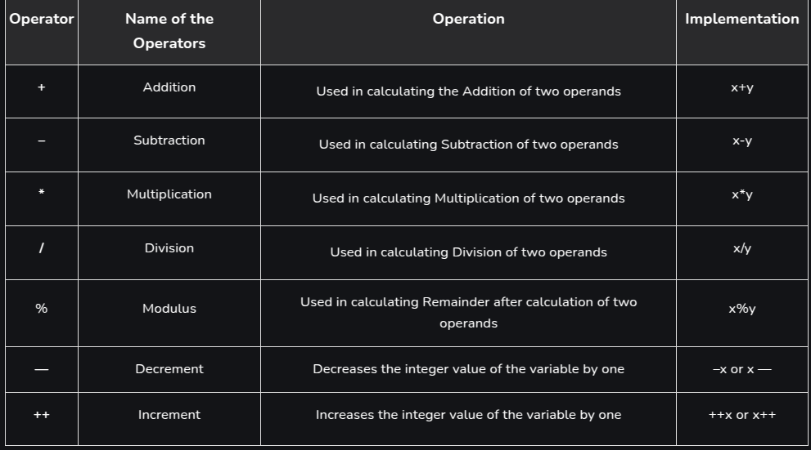
Arithmetic Operators

Slide 13
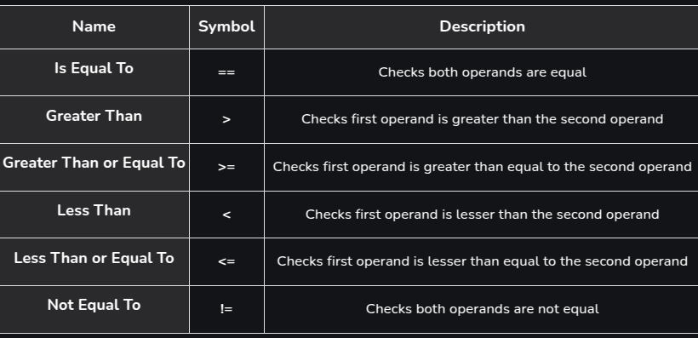
Relational Operators

Slide 14
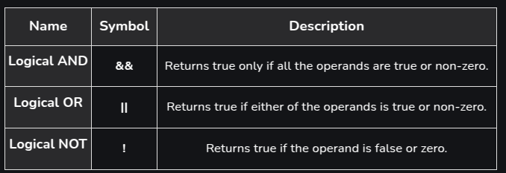
Logical Operators

Slide 15
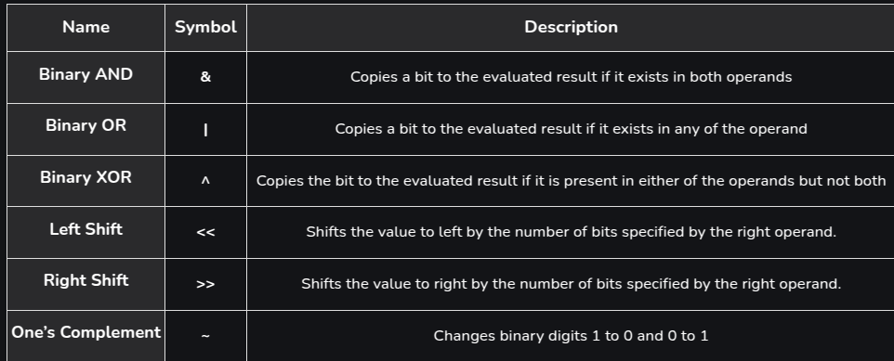
Bitwise Operators

Slide 16
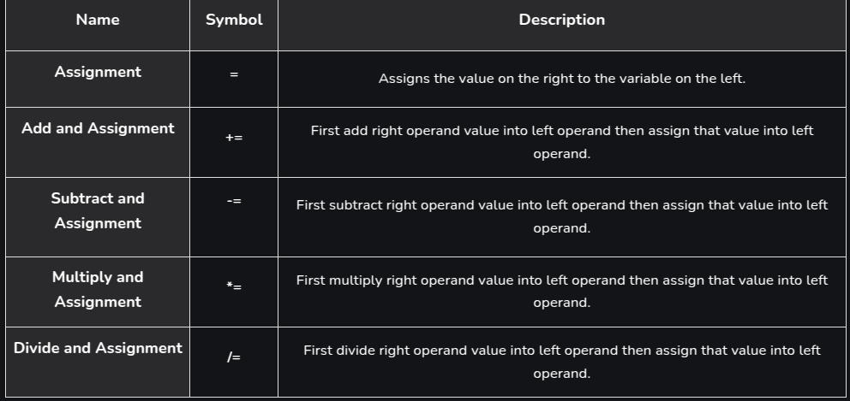
Assignment Operators

Slide 17
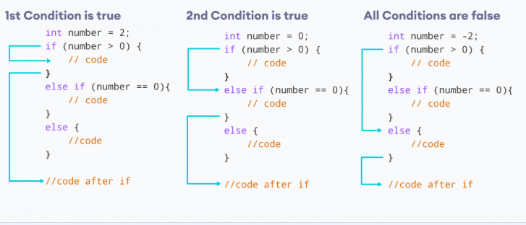
Conditional Operator (If - else)

Slide 18
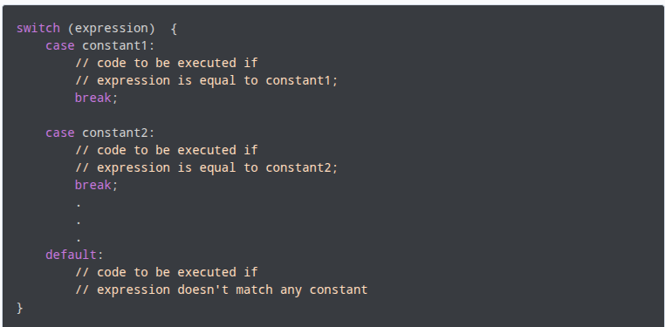
Conditional Operator (switch case)

Slide 19
Ternary Operator
Expression1 ? Expression2 : Expression 3
Sample use:
Int x = 2;
Int y = 3;
Int z = (x>y) ? x : y
cout << z;
Output:
3

Slide 20
Miscellaneous Operators
sizeof Operator: a unary operator used to compute the size of its operand or variable in bytes.
sizeof(char);
Dot Operator(.) : is used to access members of structure variables or class objects using their object names.
Obj.member
Arrow Operator(->): is used to access the variables of classes or structures through its pointer.
Ptr ->member

